Slide 1
BFX AT-100 FHD channel (live) noise FA report
Prepare by: PE – JUSTIN
Date: 2025/08/05

Slide 2
Problem Description
Issue Description (5W2H)
When | 2025-May-24
Who | SH Son
Where | ALT customer side, Location : SK networks warehouse, Anseong, Korea.
What | ALT customer return 1pc BFX-AT 100 have video FHD (1920 x 1080, codecs: H264 AVC/AAC) channel live suffers from image noise
Why | TBD
How | NG product have video FHD channel (live) image noise: S/N range: 2149688001202503069476
How much | 1pcs / 60.000 pcs ~ 0.00166% (Qty inspection lot 60k delivered on 2025.4)

Slide 3


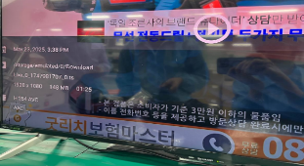
Confirm Fail Symptom
Double check fail symptom:
Use product have customer account to play “Live_0_1747981707_0.ts” video in app “MX player” ➔ FHD (1920 x 1080, codecs: H264 AVC/AAC) channel live suffers from image noise
FHD channel (live) image noise
FHD channel (live) image OK
*FHD (1920x1080) channel live video with codecs: H.264 AVC/ACC shows image noise issue (pink smearing) during playback.
Summary:
NG product play video FHD channel (live) (1920 x 1080, H264 AVC/AAC) suffers from image noise

Slide 4
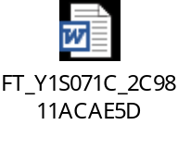
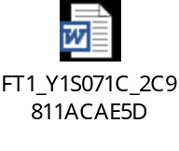
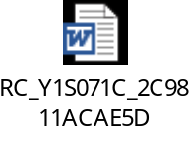
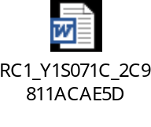
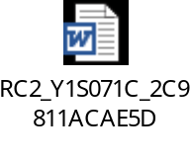
Production History Data Checking
T Level data (SMT)
SN | Test Station
Y1S071C | SMT LOADING | INSP-OUTSIDE | PCB_STOCKIN
 | 2025-03-14 16:25:11 | 2025-03-17 20:44:18 | 2025-03-17 22:02:13
Dot Level data (FATP )
S/N range | Test Station
2149688001202503069476 | UK | FT | FT1 | RC | RC1 | RC2
 | 3/22/2025 11:26 | 3/22/2025 11:34 | 3/22/2025 11:42 | 3/22/2025 12:02 | 3/22/2025 12:20 | 3/22/2025 13:17
Test logs | UK test haven’t logs test
Summary:
- This unit has PASSED normally SMT and FATP.
- Shipping date: 2025/03/26 2:45AM

Slide 5













Visual Inspection And X-ray Checking
VI checking:
SIZE | IMAGE | RESULT
TOP |  | NORMAL
BOT |  | WARRANTY SEAL BROKE
PART |  | NORMAL
X-ray checking:
S/N | U503 | U504 | U505 | U506 | U602 | U1 | U1101 | FIL1401 | FIL1402
Y1S071C
Summary:
- VI found product warranty seal broken
- X-ray: No found abnormal

Slide 6
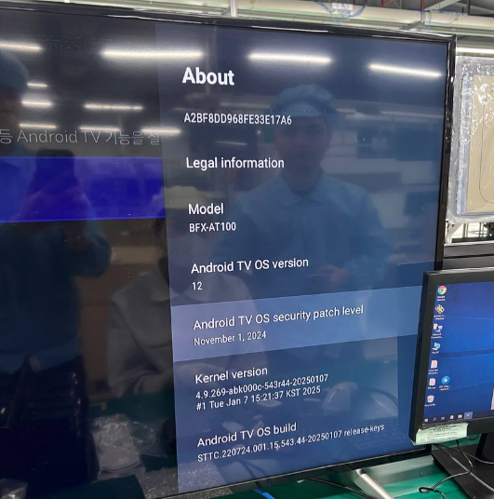
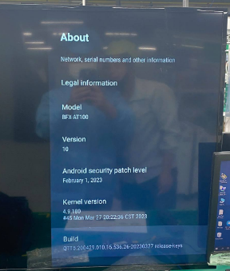
Re-test Analysis
Re-test at OBA station:
- NG DUT have account customer and use android version 12
➔ Can’t re-test at OBA station
NG DUT
Android ver 12
OK DUT
Android ver 10
Check function play YOUTUBE video at OBA station:
Video | Result
240p (426x240 30fps/codecs VP9) | PASS
360p (640x360 30fps/codecs VP9 | PASS
480p (854x480 30fps/codecs VP9 | PASS
720p (1280x720 30 fps/codecs VP9) | PASS
Video QHD (2560x1440 30 fps/codecs VP9) | PASS
Video FHD (1920x1080 30fps/codecs VP9) | PASS
Video UHD (3840x2160 30fps/codecs VP9) | PASS
COMPARE BETWEEN VIDEO FHD AT YOUTUBE AND FHD CHANNEL LIVE
Video | Resolution | Video codec | Audio Codec | Frame Rate
FHD at YOUTUBE | 1920x1080 (Full HD) | VP9 | Usually Opus or Vorbis | 30fps
FHD channel live | 1920x1080 (Full HD) | H.264 AVC | AAC (Advanced Audio Coding) | 30fps (typical for live channels)
Summary:
- Product can’t re-test at OBA station
- Check video YOUTUBE: no found abnormal

Slide 7
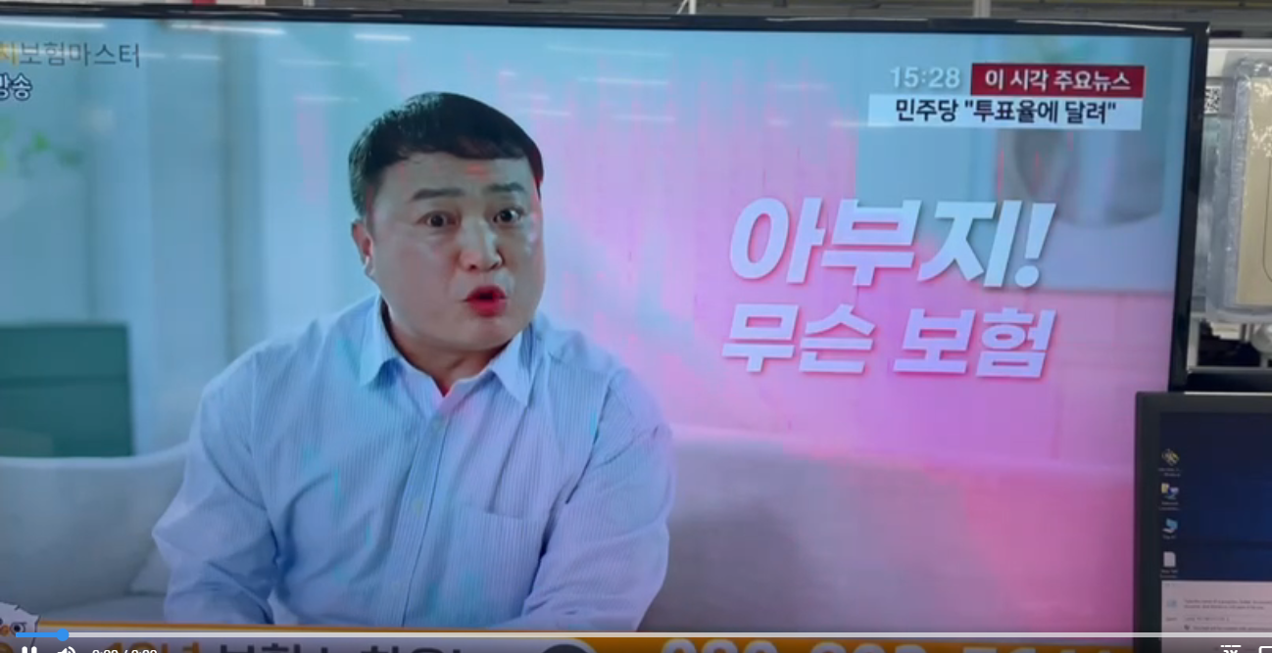

Android Version Verification
Check fail symptom at other android version:
Product | Android Ver | FA progress and conclusion by step | Image Sample
NG | 12 | *Check version of “MX player” app found NG board use old version - Update version of “MX Player” old version 1.94.4 → New version 1.97.8 → Then play video FHD channel live Result: NG product still noise image
 | 10 | *Play video FHD channel live Result: NG product still noise image
OK | 12 | Open “MX player” app and play video FHD channel live Result: OK product hasn’t noise image
 | 10
FHD channel live still noise
FHD channel live normal image
Summary:
- NG board still noise

Slide 8



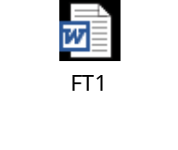
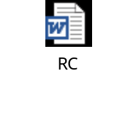

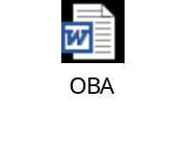
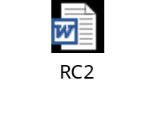
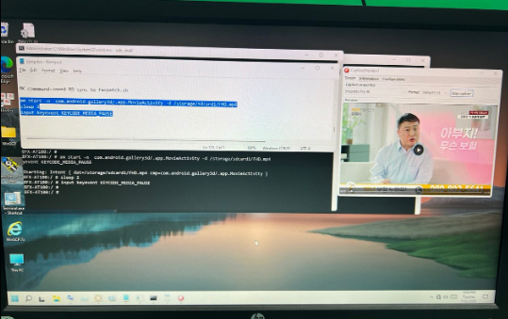
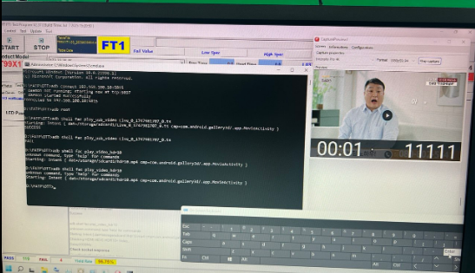
Factory Image Verification
Backup factory image
- Check console log of NG board.➔ ➔ No found abnormal
- Re-test at FATP:
Station | UK | FT | FT1 | RC | RC1 | OBA | RC2
Log
Result | Pass | Pass | Pass | Pass | Pass | Pass | Pass
Verify noise at factory image
- Play FHD channel live on NG board → Still noise image
NG
OK
Summary:
- Re-test at FATP → Pass normally
- At factory image, NG board still noise

Slide 9
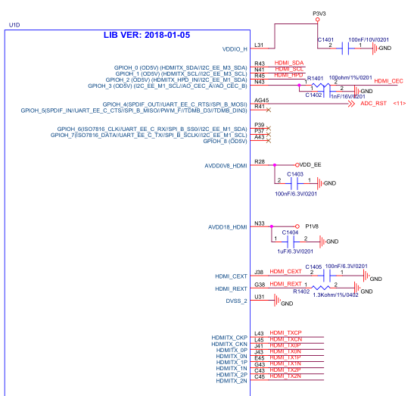
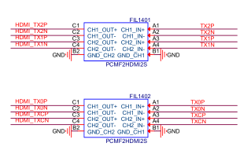
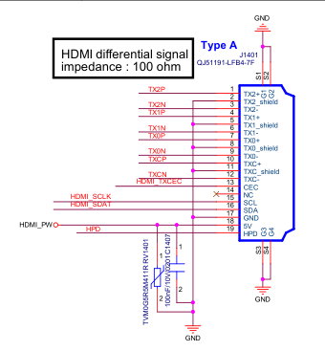
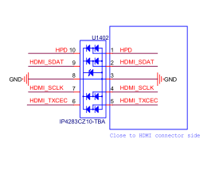
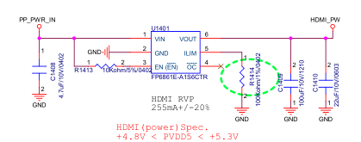
Measurement Analysis
Measurement impedance and voltage of HDMI signal
Measure impedance NG board
Signal pin | NG |  | OK sample
 | Impedance | Voltage | Impedance | Voltage
TX2P | 3.150M | 0.011 | 3.148M | 0.012
GND | 0 | 0 | 0 | 0
TX2N | 3.153M | 0.026 | 3.150M | 0.024
TX1P | 3.138M | 0.001 | 3.146 | 0.002
GND | 0 | 0 | 0 | 0
TX1N | 3.151M | 0.004 | 3.154M | 0.003
TX0P | 3.155M | 0 | 3.155M | 0
GND | 0 | 0 | 0 | 0
TX0N | 3.158M | 0.003 | 3.158M | 0.003
TXCP | 3.162M | 0.003 | 3.156M | 0.002
GND | 0 | 0 | 0 | 0
TXCN | 3.164M | 0.192 | 3.149M | 0.191
HDMI_TXCEC | 2.476M | 3.275 | 2.279M | 3.269
HDMI_SCLK | 2.447M | 5.109 | 2.459M | 5.113
HDMI_SDAT | 2.182M | 5.109 | 2.029M | 5.113
GND | 0 | 0 | 0 | 0
HDMI_PW | 1.749M | 5.109 | 1.874M | 5.113
HPD | 109.7K | 0.1 | 110.2K | 0.1
Summary:
- Impedance and voltage normal

Slide 10
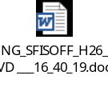

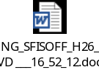

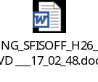
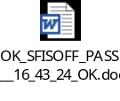
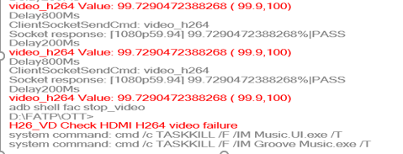
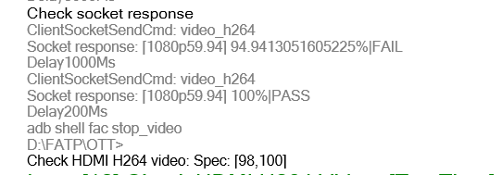
Noise Coverage Experiment
CMD verify to cover noise image
Step1: Download FHD video channel live and trimmed to 5 seconds, as the image noise issue is most clearly observed at the 1st and 2nd seconds.
Step2: A non-noise image was used as a reference sample to create the test command and perform verification.
Step3: Add command in the program at FT1 station to test and verify as below:
Product | 1st | 2nd | 3rd | 4th | 5th | Result
NG |  |  |  |  |  | Still Fail
OK |  |  |  |  |  | Pass
NG LOG
OK LOG
Step4: Then test and verify → Test program experiment can detect and cover noise image FHD video channel live
Summary:
- Test program experiment can detect and cover noise image FHD video channel live

Slide 11
Summary
No.# | Items | Result
1 | Confirm Fail Symptom | - FHD (1920 x 1080, codecs: H264 AVC/AAC) channel live suffers from image noise
2 | Production history | - No abnormal
3 | Visual Inspection And X-ray Checking | - VI found product warranty seal broken - X-ray no found abnormal
4 | OBA Function Analysis | - Product can’t re-test at OBA station - Check video YOUTOBE: no found abnormal
5 | Android Version Verification | - NG board still noise when change other android version
6 | Factory Image Verification | - Product pass normally at FATP - Noise image can detect at factory image
7 | Measurement Analysis | - Impedance and voltage no abnormal
8 | Noise Coverage Experiment | - Test program experiment can detect and cover noise image FHD video channel live
*NEXT FA:
- Co-work with RD update test plane: add item test “check HDMI H264 video” at FT1 station. Done 07/25
- CTR verify 100pcs experimental run to assess the test program before implementing in mass production. Owner: PE Justin, PD: Van anh. Due date: 08/13
- Then CTR done. We will continue further analysis. Owner: PE Justin

